Slide 1
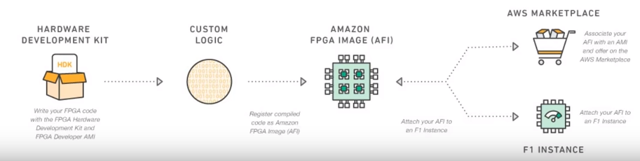
Launch the AWS provided FPGA Image (AMI) from AWS Marketplace.
Launch the Instance and connect to it.
Write code in Verilog or VHDL for RTL or optionally using open custom logic (OpenCL) framework e.g py-HDL, C, Java to describe the FPGA Logic.
Test the logic using simulator e.g Xilinx Vivado
Use vivado to synthesize and place/route the FPGA logic to create an FPGA check point (DCP).
Create an encrypted Amazon FPGA Image (AFI) using the generated DCP.
Load the AFI to FPGA.
Summary:

Slide 2
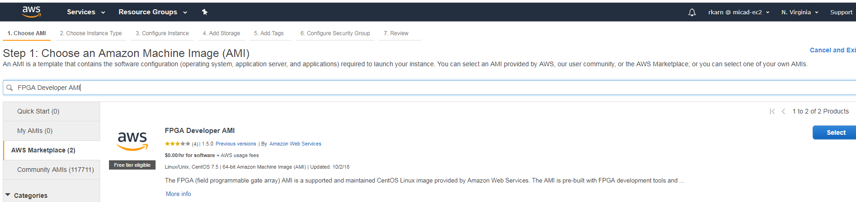
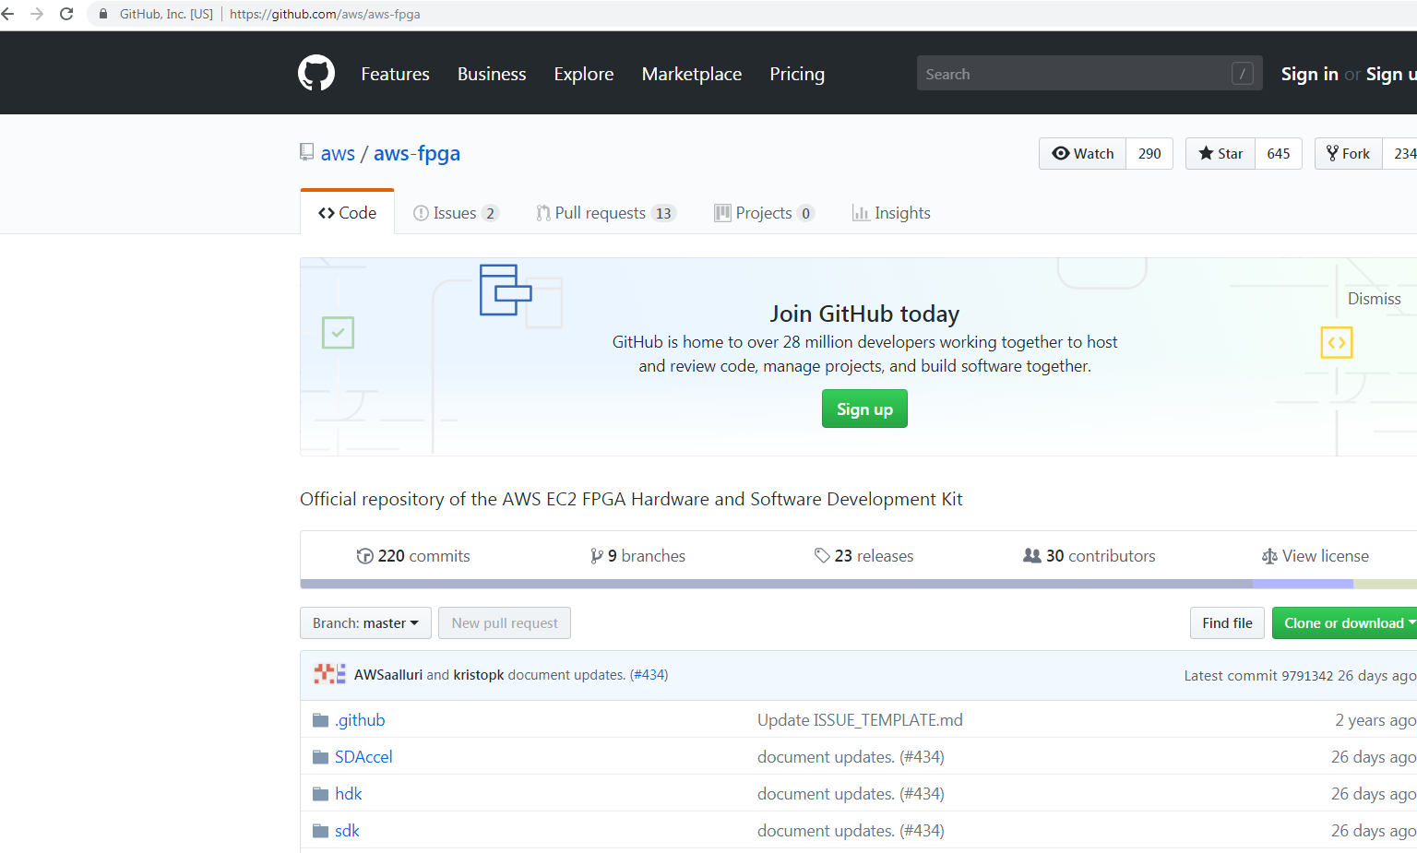

Slide 3
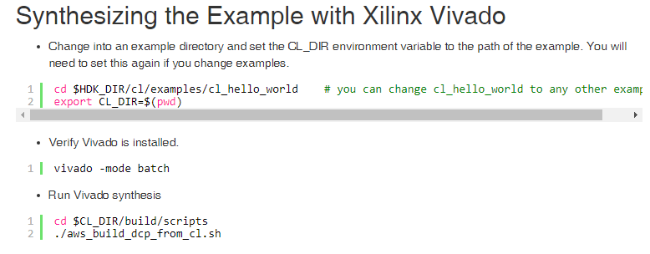
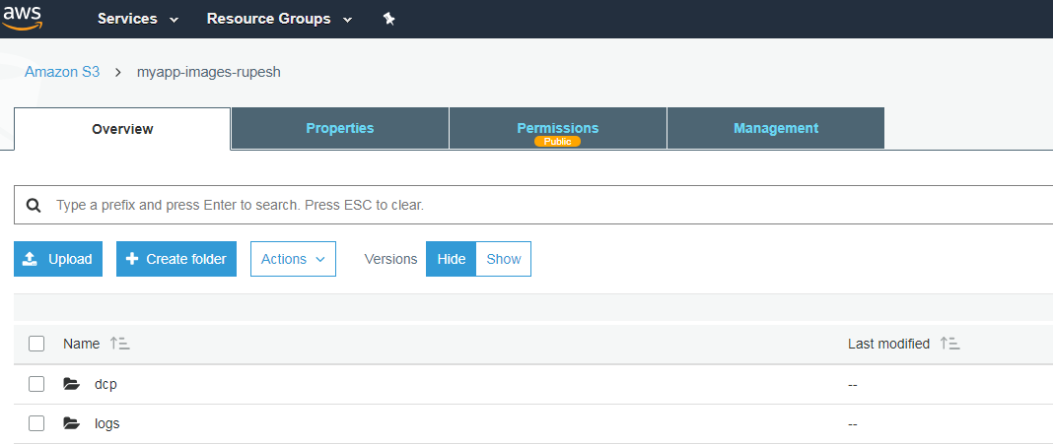
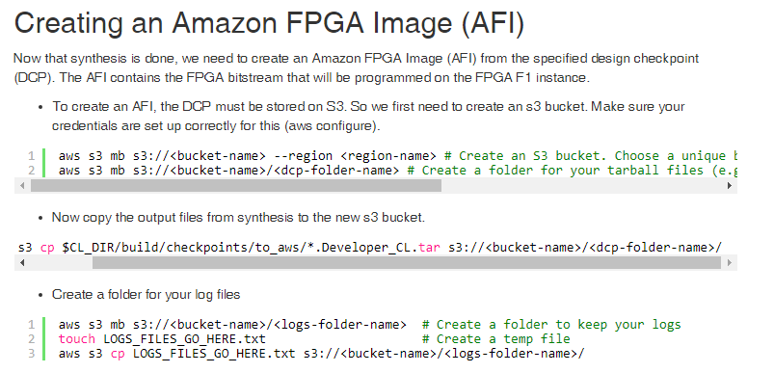
https://github.com/aws/aws-fpga/blob/master/hdk/cl/examples/cl_hello_world/software/runtime/test_hello_world.c

Slide 4
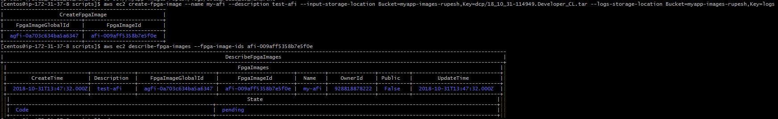
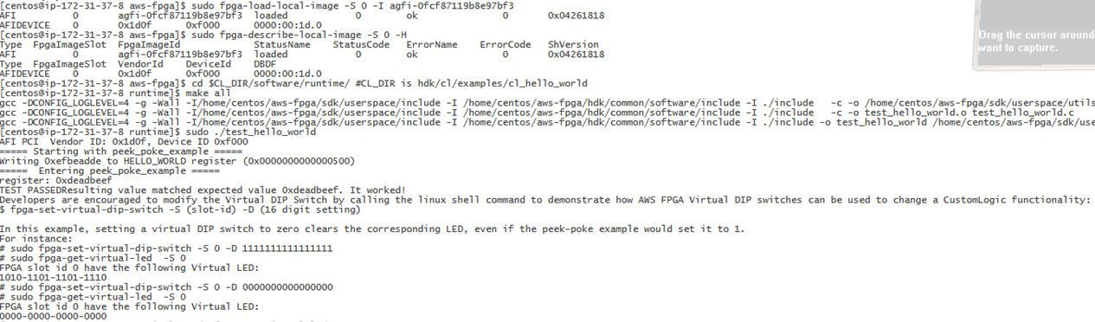

Slide 5
Useful URLs:
https://www.youtube.com/watch?v=y5hatX7j-E4
https://kivantium.net/fpga-aws
https://www.legupcomputing.com/blog/index.php/2017/08/10/step-by-step-guide-on-running-two-examples-on-the-amazon-fpga-cloud-amazon-ec2-f1/
https://www.youtube.com/watch?v=R_Wxc8y7lb0
Useful Command:
aws ec2 create-fpga-image --name my-afi --description test-afi --input-storage-location Bucket=myapp-images-rupesh,Key=dcp/18_10_31-114949.Developer_CL.tar --logs-storage-location Bucket=myapp-images-rupesh,Key=logs
FpgaImageGlobalId | FpgaImageId |
+-------------------------+-------------------------+
| agfi-0a703c634ba5a6347 | afi-009aff5358b7e5f0e

